Slide 1
Network Layer
IP Addresses

Slide 2
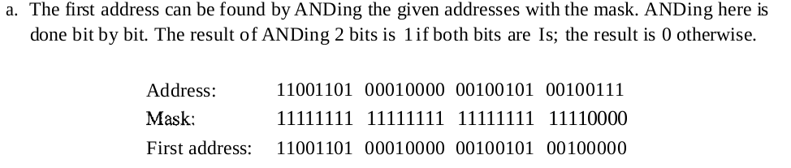
Network Layer
A block of addresses is granted to a small organization. We know that one of the addresses is 205.16.37.39/28. What is the first address in the block, What is last address?
Ans
In Example the /28 can be represented as 11111111 11111111 11111111 11110000 (twenty-eight Is and four Os)

Slide 3
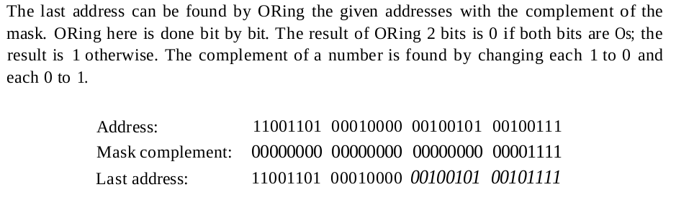
Network Layer

Slide 4
Network Layer
10.0.0.0/8
10.48.0.0/12

Slide 5
Network Layer
FA 10.0.0.0
LA 10.255.255.255

Slide 6
Network Layer
10.48.0.0/12

Slide 7
Network Layer
FA-10.48.0.0
LA-10.63.255.255

Slide 8
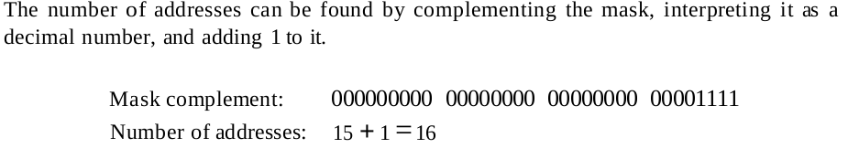
Network Layer
A block of addresses is granted to a small organization. We know that one of the addresses is 205.16.37.39/28.What is address space?

Slide 9
Network Layer
112.15.0.0/24

